Slide 1

Global Student Placement Data Challenge
Predicting Starting Salaries through Economics, Industry, and Merit
groups
Presenters
Vansky Bastien & Yoel Daniel

Slide 2

Research Questions
Can a student's total assessment score, their home country's GDP, and their chosen industry predict their starting salary?
analytics
Do students from high-income nations have a significantly higher placement rate compared to standard-income nations?
public

Slide 3
Data Sources
Primary Fact Table
Global Placement Dataset (10,000 student records detailing academics, industry, and starting salary).
storage
Dimension Table 1
Country GDP (Macroeconomic indicators for sovereign nations).
public
Dimension Table 2
Leading Industries Dataset (Global market averages and sector growth).
business_center

Slide 4
Global Placement Primary Table Metadata
Column Name | Data Type | Valid Values / Sample Values | Description
Rank | Whole Number | 1–212 | GDP rank of the country (based on economic size or GDP level)
ID | Whole Number | 1–212 | Unique identifier for each country record
Country | Text | United States, China, Germany, India, Brazil | Name of the country
Continent | Text | Africa, Europe, Asia, North America, South America, Oceania | Continent where the country is located
Population | Whole Number | 4,000,000–1,400,000,000 | Total population of the country (2023)
IMF GDP | Decimal | 0–26,695,150,000,000 | GDP value reported by the International Monetary Fund
UN GDP | Decimal | 0–18,624,475,000,000 | GDP value reported by the United Nations
GDP per Capita | Decimal | 278.43–178,196.57 | GDP divided by population (economic output per person)

Slide 5
Country GDP Dimension Table Metadata
Column Name | Data Type | Valid Values / Sample Values | Description
Rank | Whole Number | 1–212 | GDP rank of the country (based on overall GDP ordering)
ID | Whole Number | 4–894 | Unique country identifier used in the dataset
Country | Text | United States, China, Germany, India, Brazil | Name of the country
Continent | Text | Africa, Europe, Asia, North America, South America, Oceania | Continent where the country is located
Population | Whole Number | ~4 to 1,400,000,000 | Total population of the country (2023)
IMF GDP | Decimal | 0 to ~26.7 trillion | GDP reported by the International Monetary Fund
UN GDP | Decimal | 0 to ~18.6 trillion | GDP reported by the United Nations
GDP per Capita | Decimal | 278.43 to 178,196.57 | GDP per person (GDP ÷ Population)

Slide 6
Global Industry Metrics Dimension Table Metadata
Column Name | Data Type | Valid Values / Sample Values | Description
Industry | Text | Tech, Healthcare, Finance, Consulting, Manufacturing, Other | Industry sector in which students are employed
Market Avg Salary | Whole Number | 65,000–115,000 | Average salary offered in each industry
Projected Growth Rate | Decimal | 3.2–8.5 | Expected annual growth rate (%) of the industry
Global Market Value (Billions) | Whole Number | 900–22,500 | Total global market size of the industry in billions USD

Slide 7
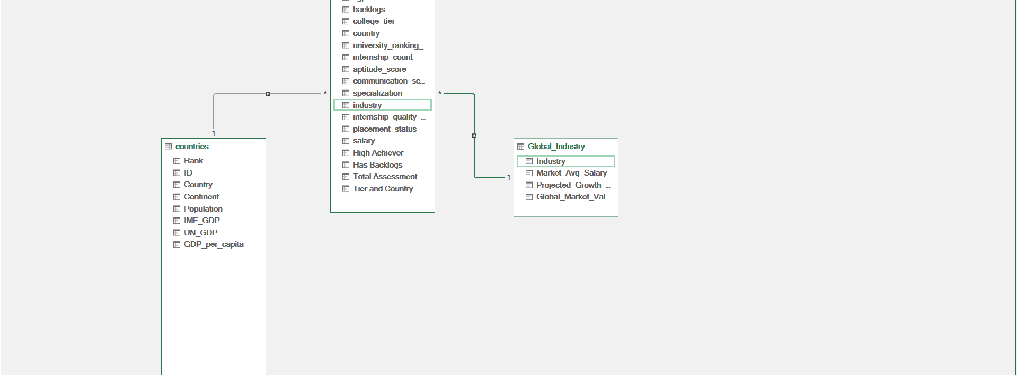
Building the Data Model
Entity Relationship Diagram

Slide 8
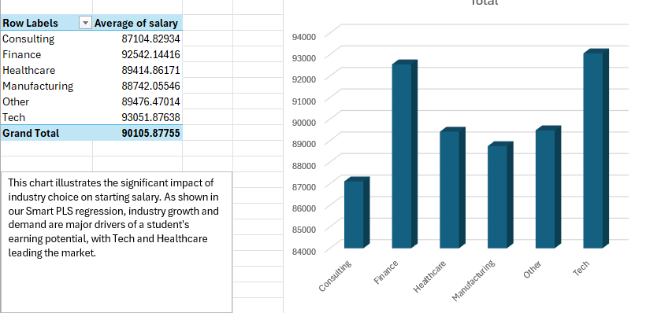
Average Salary by Industry
Key Insights
The industry a student chooses heavily dictates their baseline starting salary.
Tech and Healthcare lead the market, offering significantly higher entry-level compensation compared to sectors like general manufacturing.
This disparity highlights the importance of strategic career planning and industry research for graduating students.

Slide 9
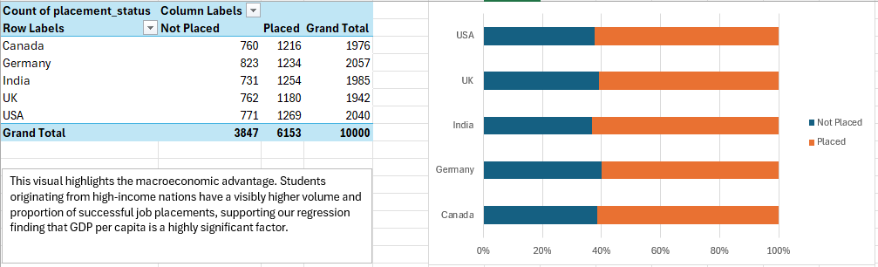
Placement Rates by National Wealth
Key Insights
Students from high-income nations have a visibly higher volume and proportion of successful job placements.
Where a student originates matters.
This visual highlights the macroeconomic advantage. Students originating from high-income nations have a visibly higher volume and proportion of successful placements, suggesting that GDP per capita is a highly significant factor.

Slide 10
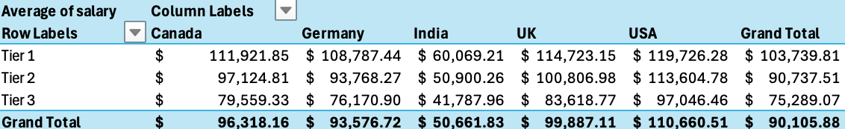
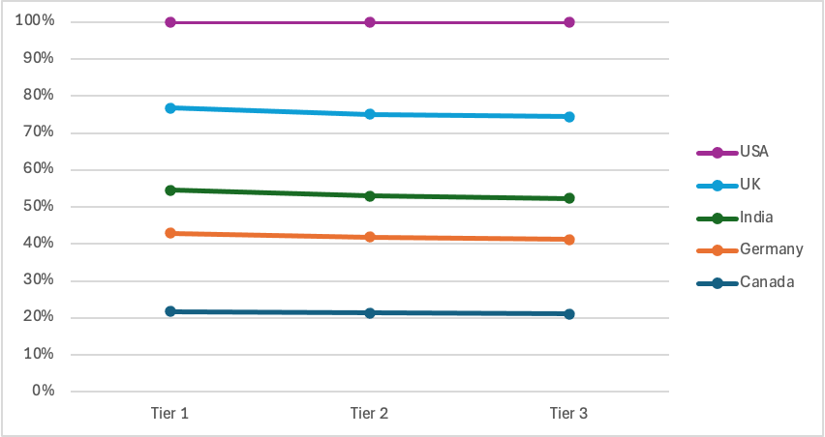
Salary by College Tier
Key Insights
Students from Tier 1 schools tend to earn more no matter where they’re from. Location still has a strong influence on salary.
This chart shows how school prestige and location work together. Going to a top-tier university helps, but where a student is from still plays a big role in how much they earn, showing that larger economic factors are hard to ignore.

Slide 11
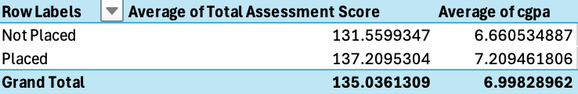
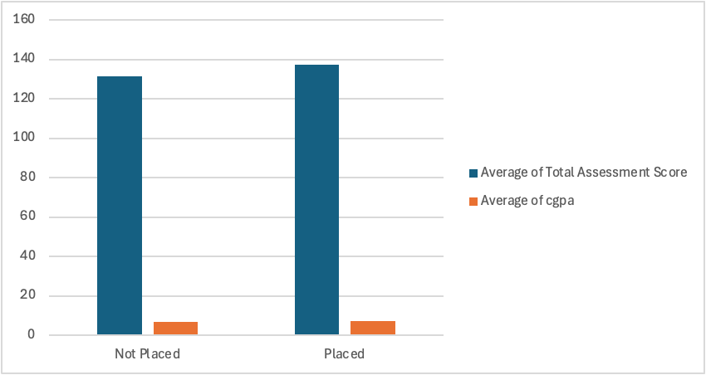
The Assessment Score Comparisons
Key Insights Students who were placed and not placed have nearly the same CGPA and assessment scores. Academic performance alone doesn’t strongly predict job placement.
This chart goes against what you might expect. The averages for CGPA and total assessment scores are almost identical for both groups, which supports our Smart PLS results showing that these academic metrics don’t have a significant impact on career outcomes.

Slide 12
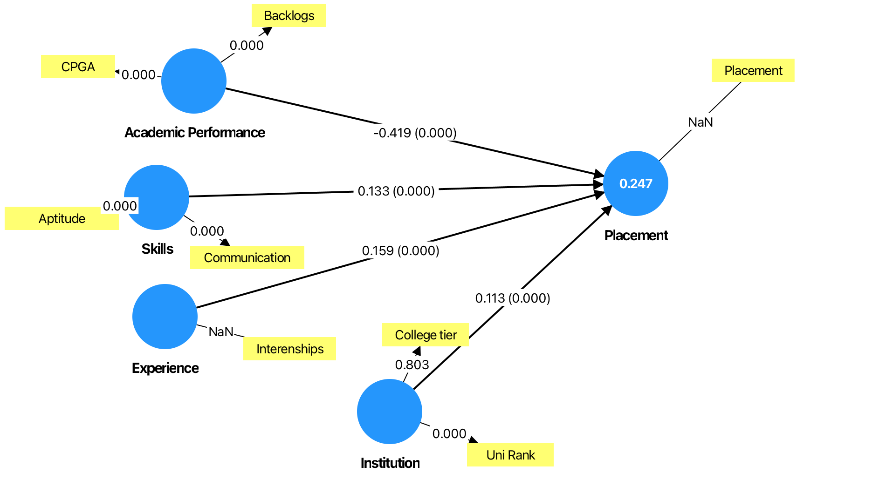
Smart PLS Dataoutput

Slide 13
SmartPLS Results
Our model used Academic Performance, Skills, Experience, and Institutional Factors to predict Student Placement outcomes.
The model explained 24.7% of the variation in Placement (R² = 0.247), showing a moderate level of explanatory power. Among the predictors:
Academic Performance was the strongest predictor, with a path coefficient of -0.419 and a p-value of 0.000, indicating a statistically significant relationship. Interestingly, this relationship is negative, suggesting that higher academic performance is associated with lower placement outcomes in this dataset. This may be due to how the variables are structured or the influence of other non-academic factors.
Experience had a significant positive effect, with a path coefficient of 0.159 and a p-value of 0.000. This indicates that students with more internship experience tend to have a higher likelihood of being placed.
Skills also showed a significant positive relationship with placement, with a path coefficient of 0.133 and a p-value of 0.000, suggesting that stronger aptitude and communication skills slightly improve placement chances.
Institutional Factors had a small but significant positive effect, with a path coefficient of 0.113 and a p-value of 0.000, meaning that college tier and university ranking have a modest influence on placement outcomes.
Overall, the results suggest that placement is influenced by a combination of academic, skill-based, experiential, and institutional factors, with experience and skills contributing positively, while academic performance shows an unexpected negative relationship in this dataset.

Slide 14


